Slide 1



TransNational On-line Partners Meeting
November 10, 2020
EKO Grammar School and VET School of Multimedia Studies Poděbrady, Czech Republic

Slide 2


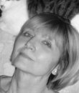
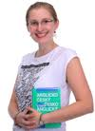
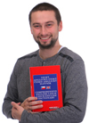
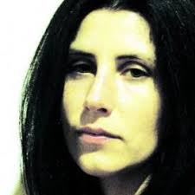
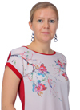
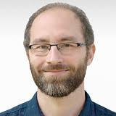
Teachers:
Eva Svobodová
Kateřina Zumrová
Technicians:
Aleš Bezouška
Leona Kubišová
Monika Martínková
Šimon Chloupek

Slide 3
Czech team for O1 = Motivation + Best Practice Example + Focus Group (01 = 20 pages limits!)
Posting on EKO Grammar School Poděbrady plus link to BABBAT web page (original idea Riseba project web)
Motivation: results of researches and consultations
Best Practice Examples:
English and national language versions
Photos and the video
Focus Group experts:
15 (!)

Slide 4

Ad Motivation
Hansina helped with a pattern = approx. same outline
- Researches necessary
- Benefits and hindrances
- Quotations
- Consultancies (Marios, Nellija Titova)
Ad Best Practice Example
- Easy or difficult to find or choose
- Easy or difficult communication
- The most complicated part = video (length)

Slide 5
Ad Focus Group
- Experts involved in educational zone = preparing for labour market
- Experts analyzing (un)employment rates and reasons
- Not only ideal experts but those who agreed to participate, to provide photos and contacts
- FAQ: How time demanding the participation is?
Czech team role:
- To coordinate deadlines, content and quality of received materials
- To assure all the partners had the needed info and patterns
- Transfer design visions to technicians – simple, clear, easy to read
- Listen to proposals – changed the outline from M+BPE+FG into packages

Slide 6
Present work
- posting all the videos = dilemma:
- on the Riseba project web and link in O1 on Poděbrady web
- or full posting in Poděbrady and link to O1 web in Riseba project web
APV = Added Project Value in Covid-19 times:
- Many bankruptcies and job losses
- Urgent career restart or a new start-up
- To encourage, not to give-up
BABBAT as the first step for new beginnings

