Slide 1
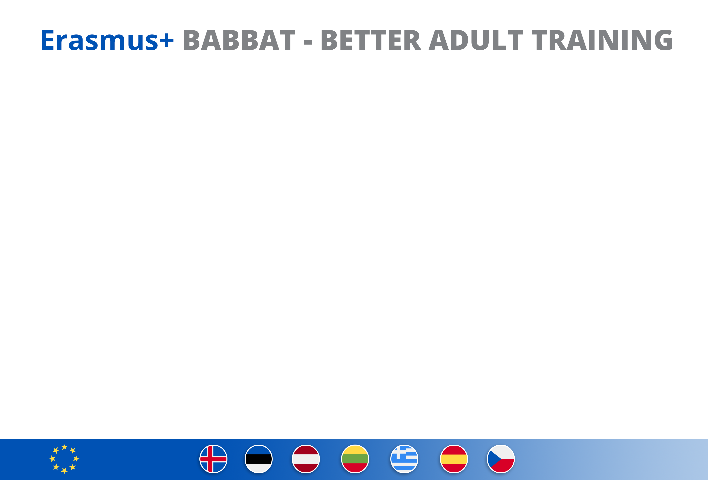
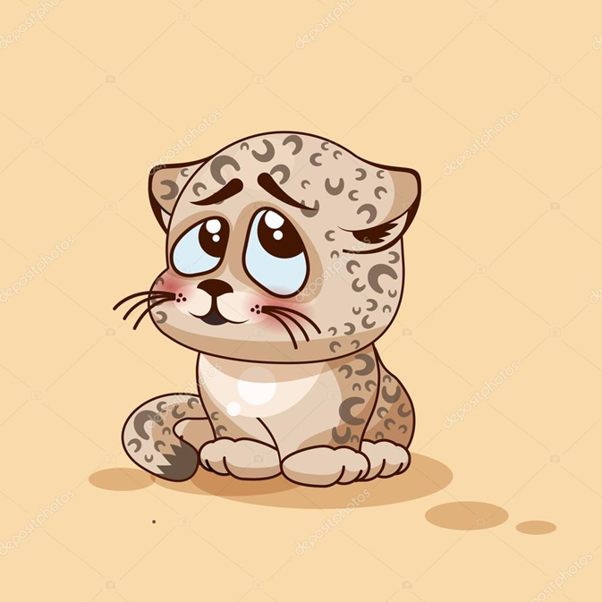


Obstacles for Not seeking educations
Low self esteem – low self images – difficult to “walk over the threshold”
Locations – more difficult in rural areas
No support
Little time
Don’t know where to find a right educations
Too expensive
Very difficult to motivate people to start over again
Covid has make things more difficult due to Digital skills
Example form 29 year old guy;
“ I have always felt like a looser and I had really bad self images –
I felt that I had failed and I was too old to start all over with my studies. All my friends just carried on and finished.
I had never thought of this “set back“ in a positive ways – like a resources, and that I actually now, after starting over, I might be a good examples for others “

Slide 2
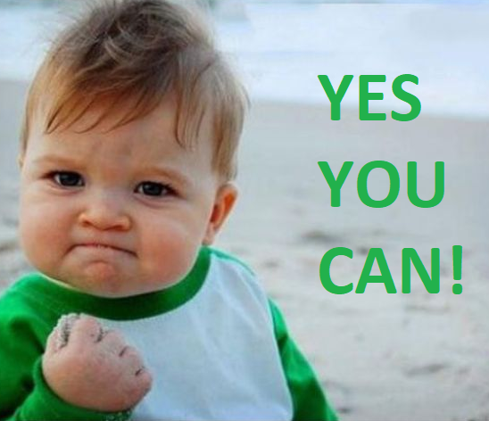
Positive experience from seeking educations
Stronger self esteem – personal growth
Good – better images
Better job – more possibilities
Better security
Possibilities to enter “ into other, new and more exiting areas”
Feeling eager to give back – support others,
Example form 49 year old lady; who took the B text (Master) increased driving licences, and started her own Taxi driving business:
“ Feeling like I can do many different thing, and today I am proud about my situations and my achievement – I feel that I had finally something positive to say in family gatherings or meeting friends, like that suddenly my NAME had a different meaning to people…. “

Slide 3
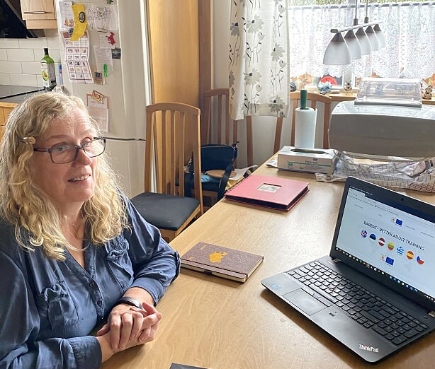
Meet Hafdís Þórðardóttir b. 1953,married and mother of 6 and a grandma living in a rural area of Vest Iceland.
She graduated from the University of Iceland in 2007,as a developmental therapist,
when she was in her late fifties and has since then, worked on her main interest which is caring for disabled individuals.
https://www.youtube.com/watch?v=ktVGoNVl1rg

