Slide 1


TransNational On-line Partners Meeting
November 10, 2020

Slide 2

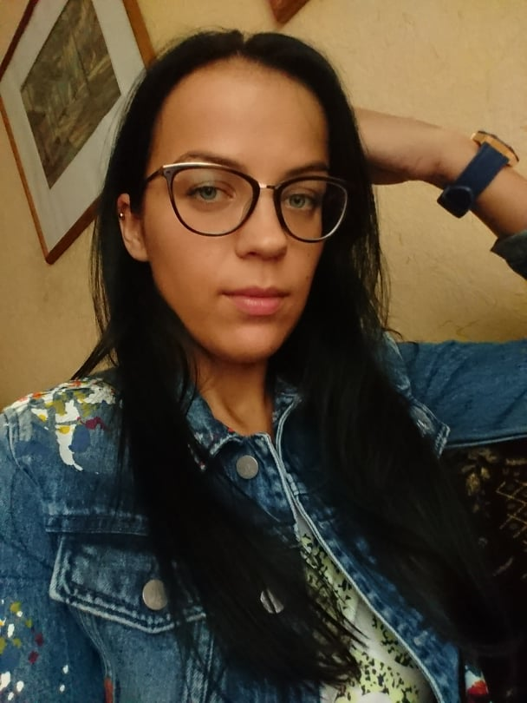
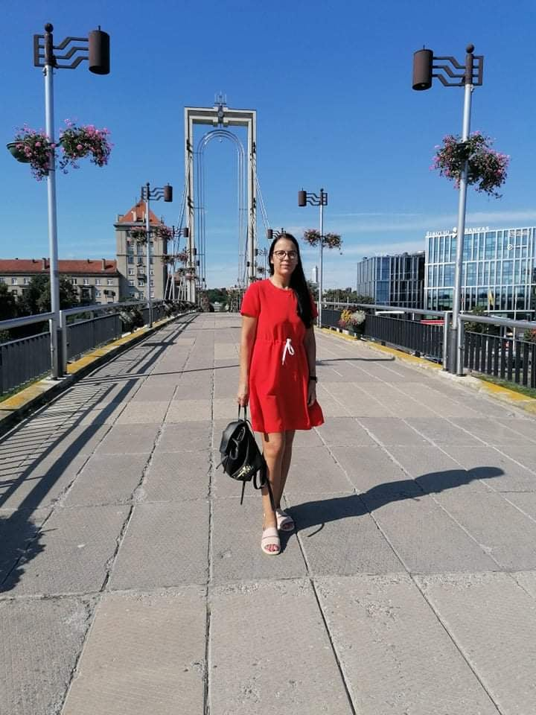

Meet Fausta from Lithuania who with the help of BABBAT project partner VšĮ Žmogiškųjų išteklių stebėsenos ir plėtros biuras is buidling up her confidence, trying to get skills necessary for the labour market and creating better future for her daughter and herself.
Good Practice Example
Lithuania

Slide 3
Obstacles of education/ training later in life:
- Lack of flexibility of certain programmes;
- Family commitments; no support network for, for instance, single mothers from the local or national government;
- Missing link between the training providers and the target groups (how to reach them – in terms of marketing/ dissemination tools);
- Lack of motivation;
Benefits of education/ training later in life:
- Personal satisfaction with one’s life, self-realisation;
- Ensuring better life quality for the loved ones;
- Knowing what you want and need and how to get it;
- Increased self-confidence;
- New connections.
LESSONS LEARNT

Slide 4
1. BABBAT facebook
2. Our website
3. Our facebook (2150 followers);
4. Presenting project to persons of the focus group (15 members);
5. Presenting the project to a group of low qualified adult learners to invite them to share their story for the video (10 members);
6. Sharing the article in LT and EN on EPALE platform
DISSEMINATION

