Slide 1
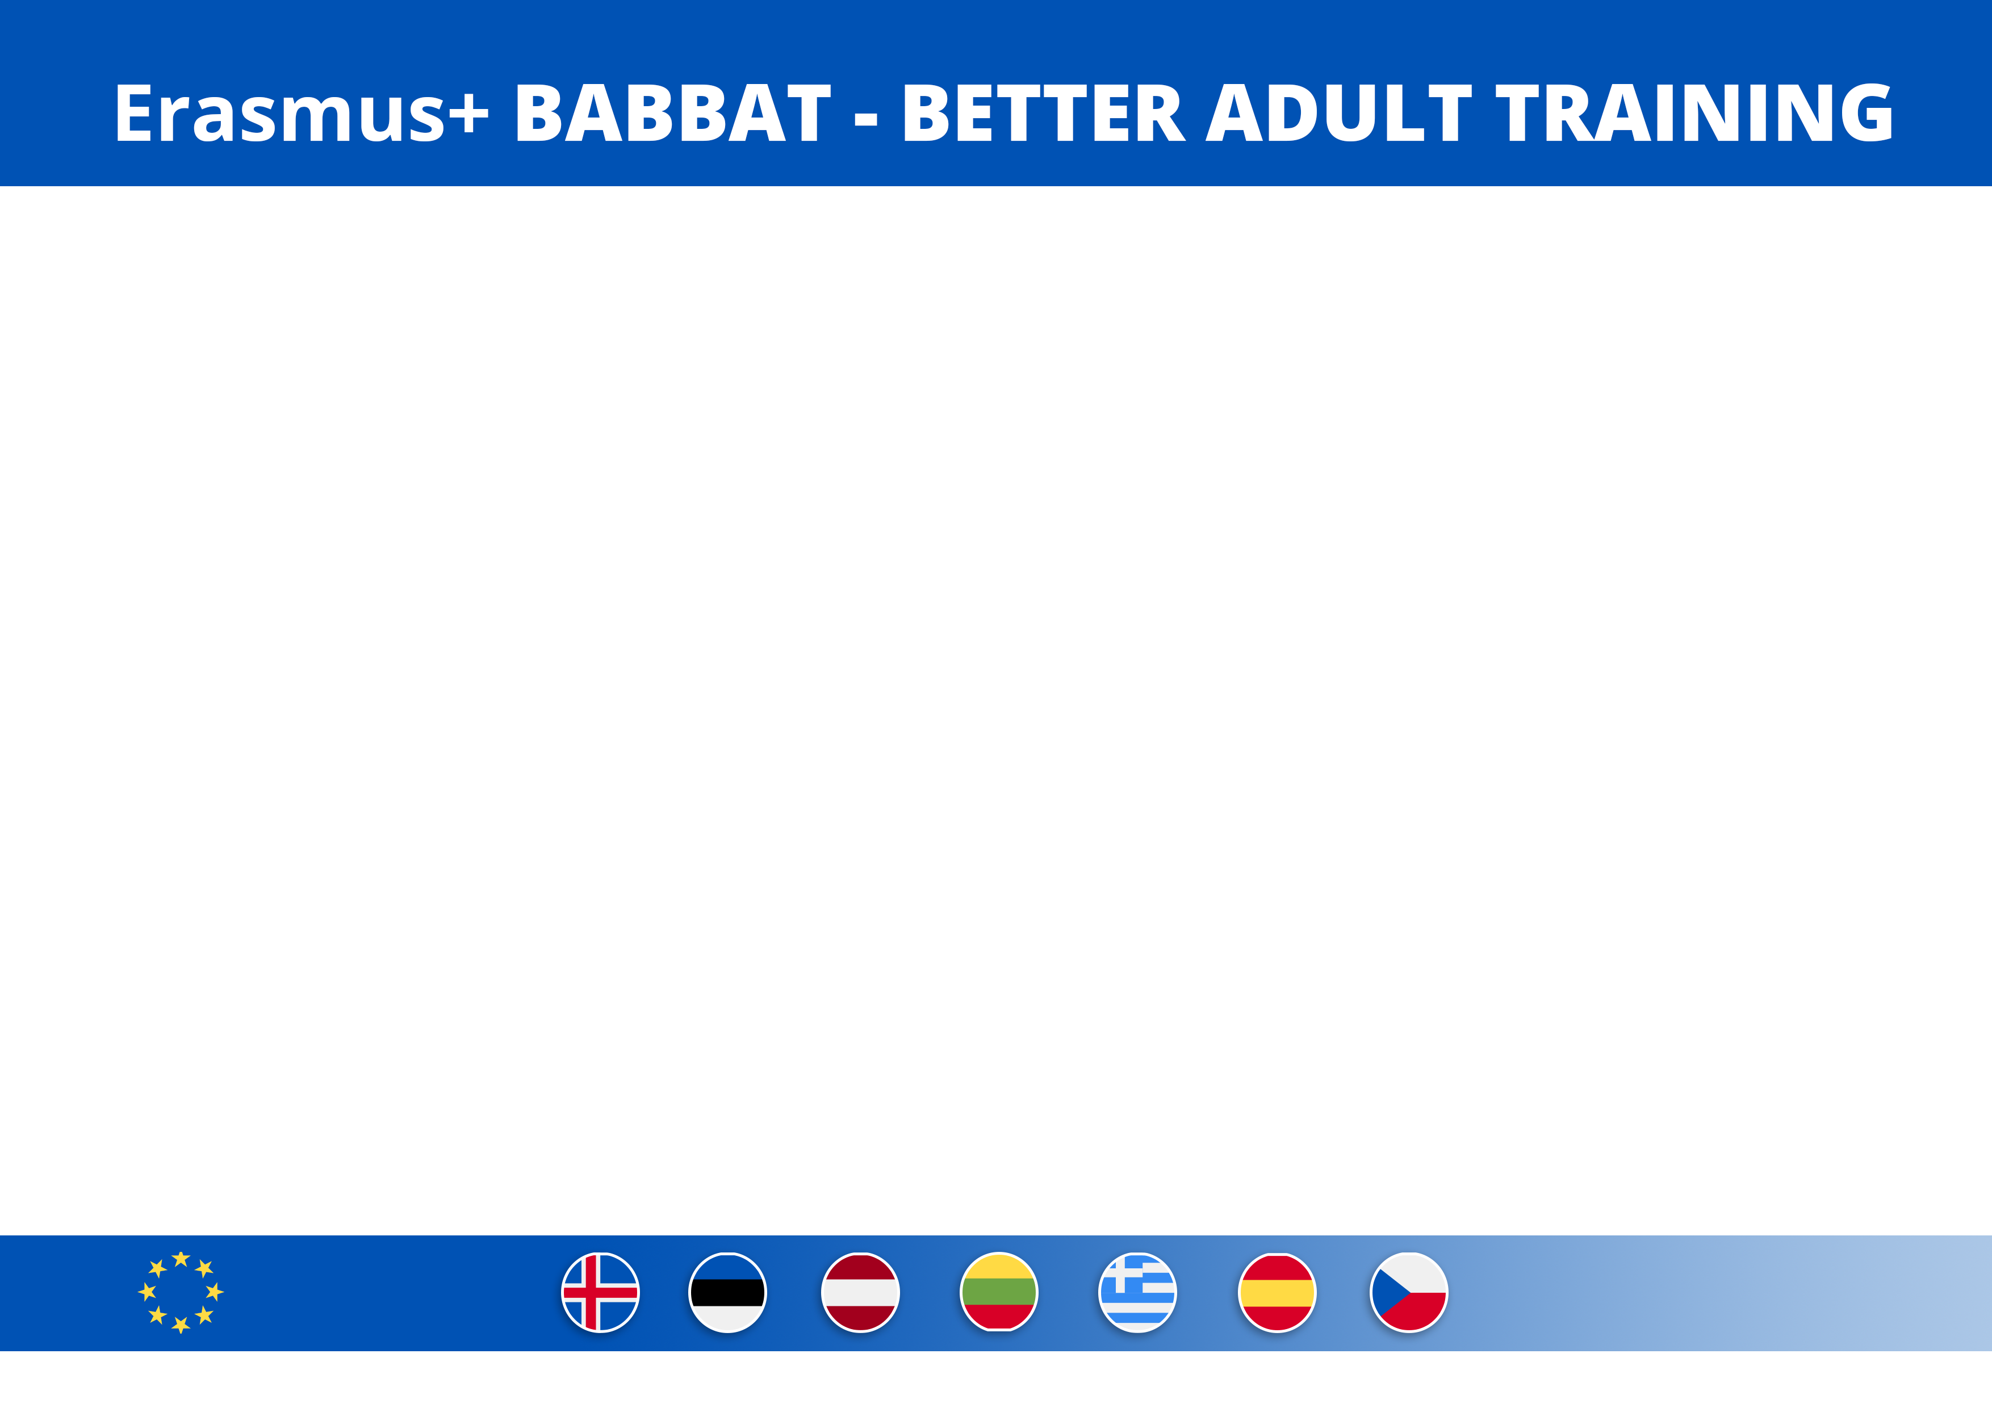

TransNational On-line Partners Meeting
November 10, 2020

Slide 2
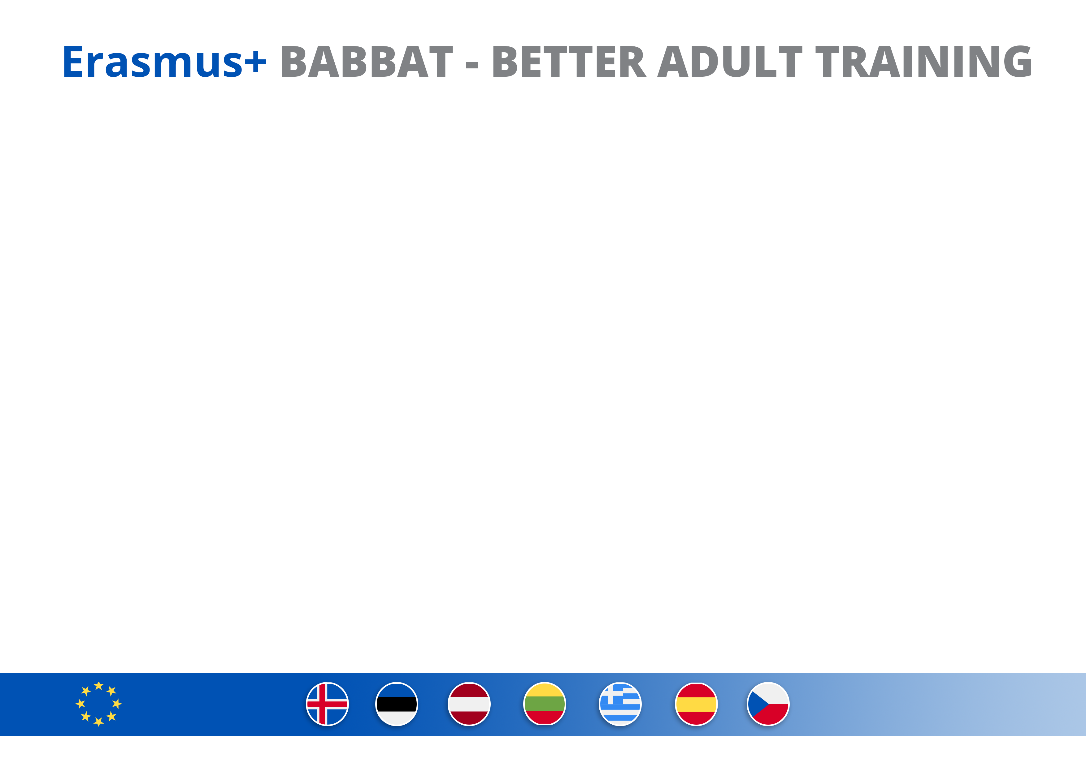
Obstacles of education
- No time.
- No interesting topics/subjects to lean.
- No strong teachers/trainers who can teach adults.
- No useful certificates/diplomas after learning.
Benefits of education
- Opportunity for up-skilling and reskilling.
- Opportunity to find new job.
- Opportunity for inclusion (socialisation).
- Opportunity to learn something new for self-esteem.
LESSONS LEARNT

Slide 3
1. BABBAT Facebook page https://www.facebook.com/betteradultlearning
2. Eesti People to People websitehttp://www.ptpest.ee/1140.html
3. Eesti People to People Facebook page https://www.facebook.com/Eesti-People-to-People-1040259346025140 (1160 followers).
4. Presenting project to Eesti People to People members (10 people).
5. Presenting project to members of AKÜ - Estonian Roundtable for Development Cooperation – during annual meeting.
6. Presenting project to members of ENUT - women umbrella organisation – during annual meeting.
7. Presenting project to adult learners (10 people).
8. Presenting project to focus group members (15 people).
DISSEMINATION

Slide 4
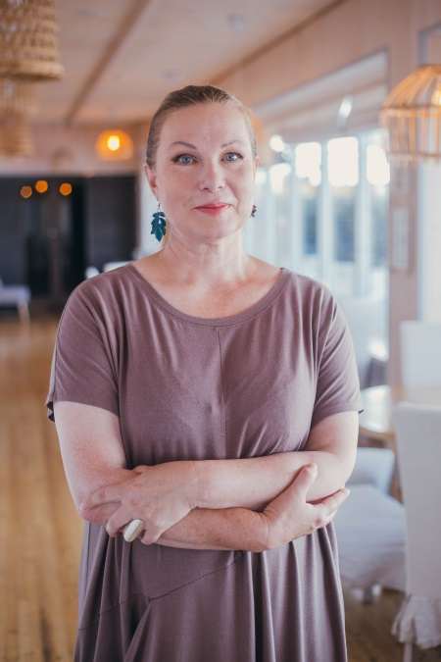
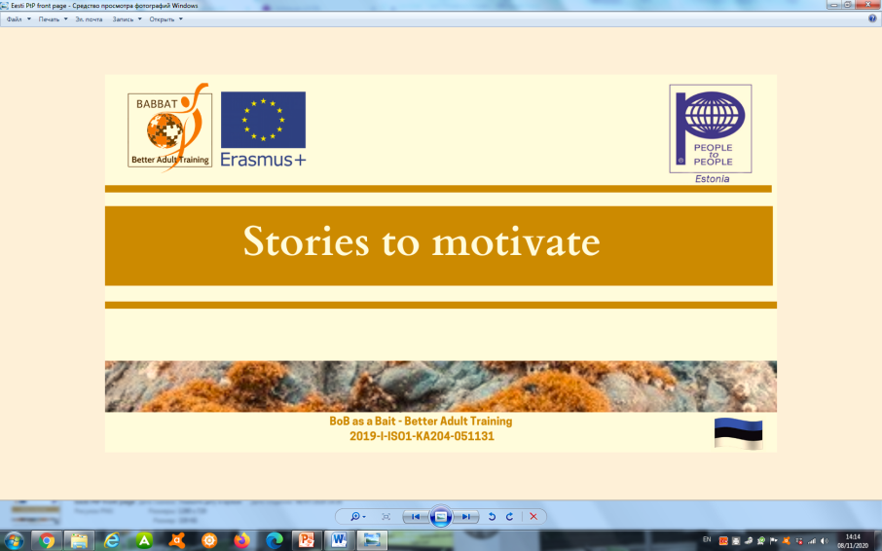
Jelena Parfjonova tells her story how from formal education sector she moved to non-formal education and now run “Academy of Childhood” NGO and kindergarten, trains unemployed people and high school students, participate in Erasmus+ projects and learns all the time to be suitable for labour market and to have competences of XXI century.

